Slide 1
VENUE LOCATION RECOMMENDATION
French restaurant in Hong Kong

Slide 2
Stakeholder Description
Aim: opening a new restaurant in Hong Kong
Characteristics of the stakeholder business
French culinary
Started as a small bistro
Multinational and Michelin-starred
“Expensive, exquisite, and expensive” (3 E’s)

Slide 3
Location Criteria #1
Proportion of French restaurants to all types of restaurants: this factor indicates the potential demand for French restaurants in a given area -- lower proportion, higher likelihood. Proportion is used here instead of the sheer number of French restaurants, because less numbers may mean that there just are not enough demands due to less foot traffic, lower residential density, etc.

Slide 4
Location Criteria #2
Price points of the French restaurants in the vicinity: the business of the stakeholders aims for the best cuisine that money can buy, no moderation on ingredients or human resources whatsoever. This means the effect of a budget French restaurant on the potential demand of the stakeholder's restaurant would be less than a French restaurant with a similar price point.

Slide 5
Location Criteria #3
Ratings of the French restaurants in the vicinity: nearby French restaurants with lower ratings would have less impact on the profitability of the new branch to be opened by the stakeholders, and vice versa.

Slide 6
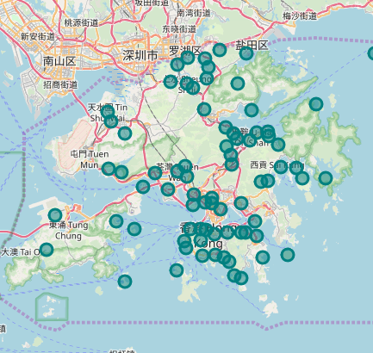
Coordinates used
Each point visualized in the map was evaluated based on the three location criteria.
The evaluation was performed using Foursquare API and Google geocoder.
Then, the coordinates were clustered using k-means.

Slide 7
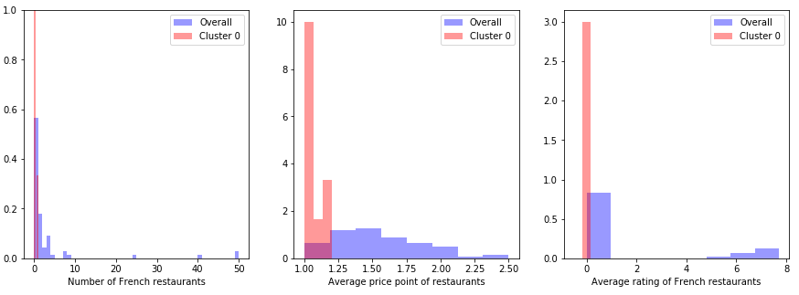
Cluster 0: The Fringe
In comparison to the overall trends in Hong Kong, the regions in this cluster have few to zero French restaurants
Nearby restaurants have lower price points. Thus, not compatible with the high-price business model
Will not be considered further.

Slide 8
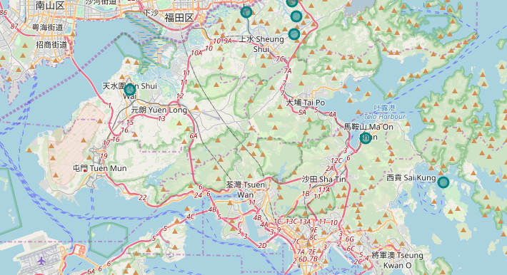

Slide 9
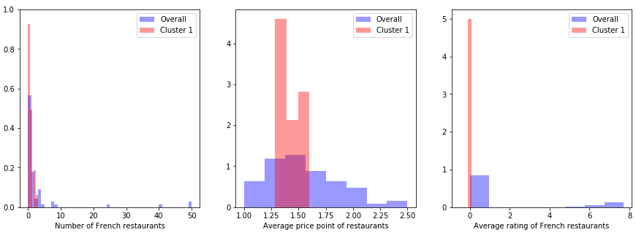
Cluster 1: Dizygotic Twin of Cluster 0
Like cluster 0 except for the higher price point on average
Will not be considered further.

Slide 10
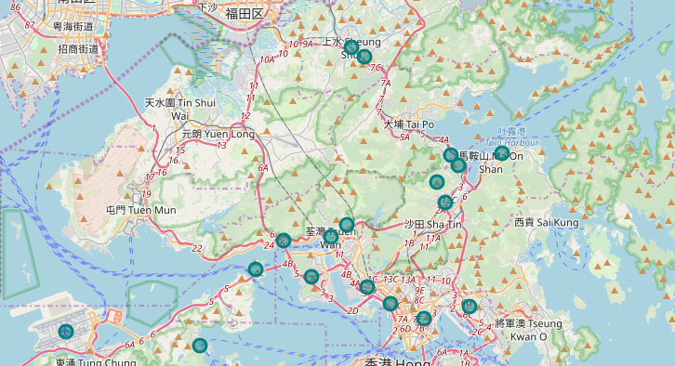

Slide 11
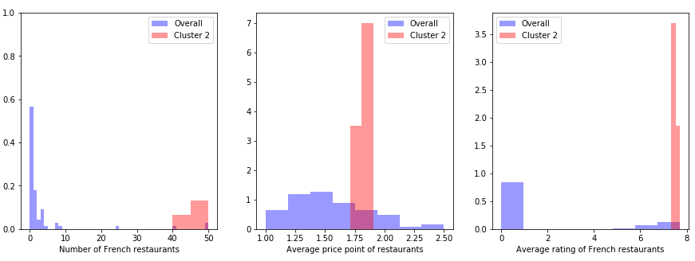
Cluster 2: Little Paris
Highest number of French restaurants with very high ratings
Average price point of the restaurants also higher than most other clusters
Fierce competition expected from existing French restaurant businesses

Slide 12
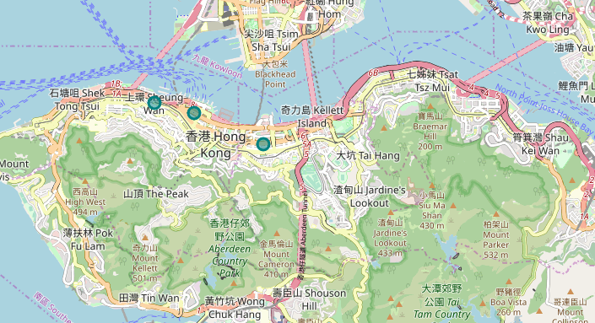

Slide 13
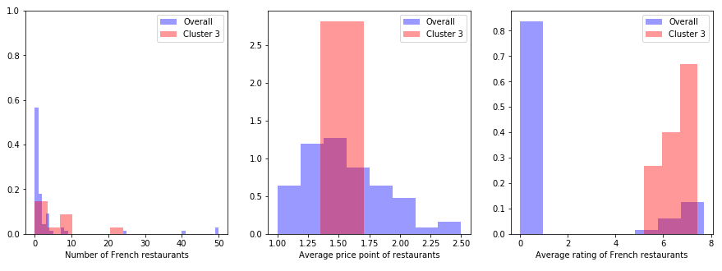
Cluster 3: Middle of the Litter
Zero to several French restaurants with diverse ratings
Average price point of other restaurants in the vicinity (middle class customers expected)
Moderate level of competition from other French restaurants predicted

Slide 14
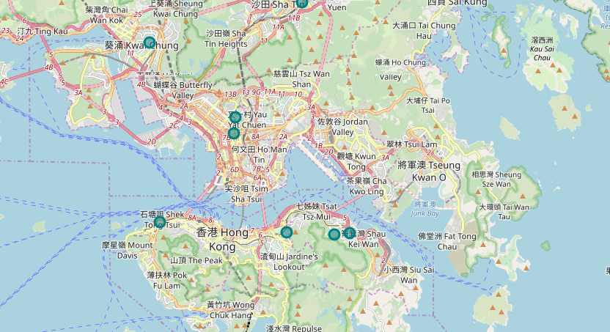

Slide 15
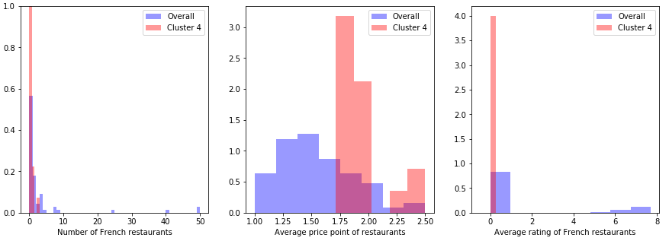
Cluster 4: Opulent Dens
Few to zero French restaurants
Higher percentile of the price point of the nearby restaurants
Pre-established French restaurants have zero ratings (not very rooted)
Target customers abundant with negligible degree of competition from other businesses expected

Slide 16
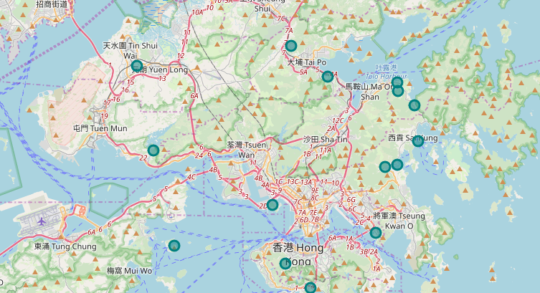

Slide 17
Top Candidate Locations
The top 3 locations were selected from cluster 4.
In cluster 4, number of French restaurants and ratings of French restaurants do not vary much and have no effect on decision making.
The candidate locations, therefore, were selected based on the affluence of the neighborhood.

Slide 18
